Slide 1
8255 PPI
Dr. Manju Khurana
Assistant Professor, CSED
TIET, Patiala
manju.khurana@thapar.edu

Slide 2
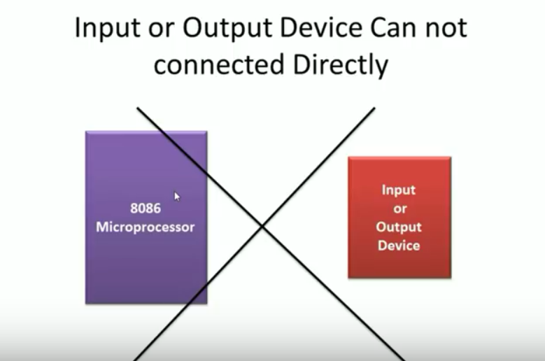

Slide 3
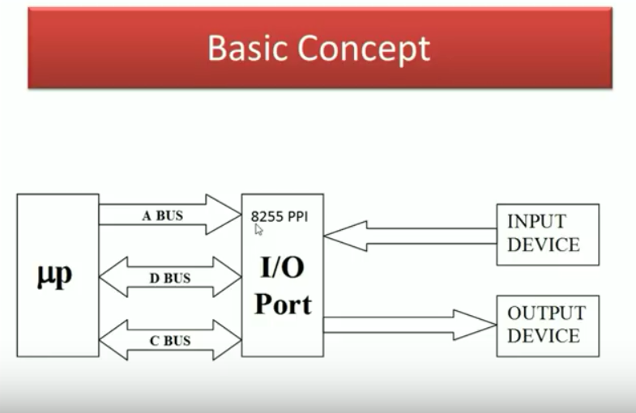

Slide 4
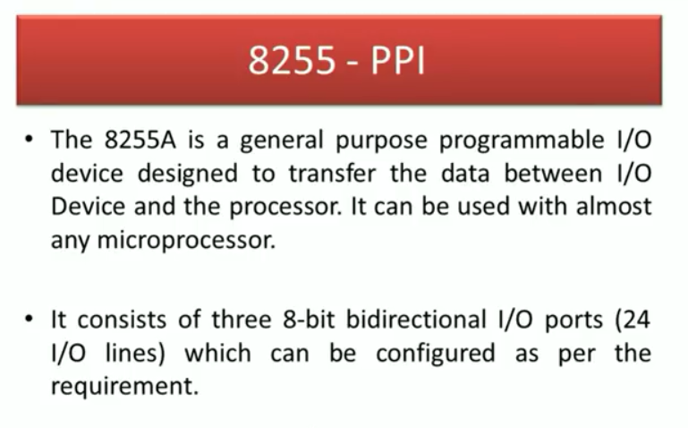

Slide 5
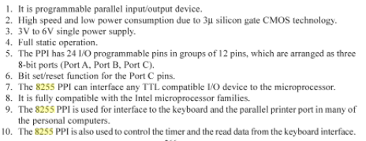
Features of 8255 PPI

Slide 6
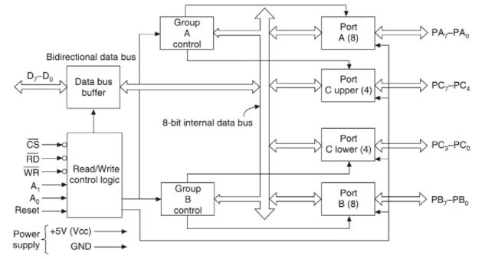
Architecture of 8255

Slide 7
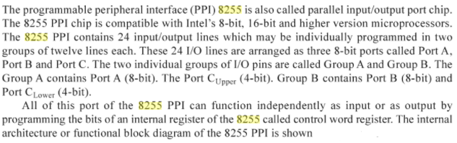
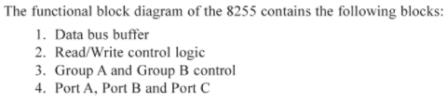
Architecture of 8255

Slide 8
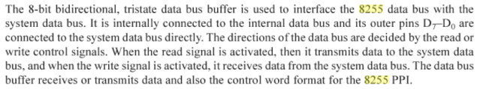
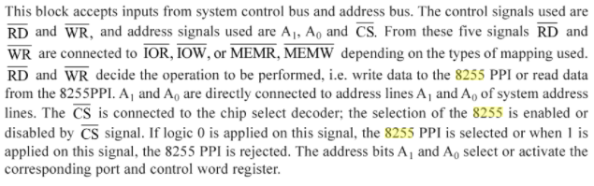
1. Data Bus Buffer
2. Read/Write Control logic

Slide 9

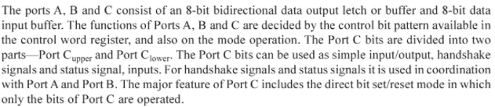
3. Group A and Group B Control
4. Port A, Port B and Port C

Slide 10
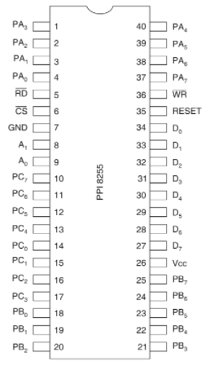
Pin Configuration of 8255

Slide 11
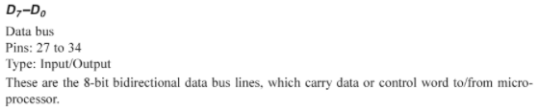


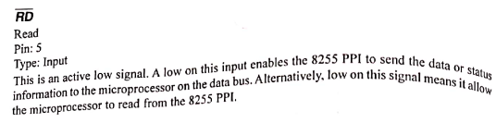

Slide 12
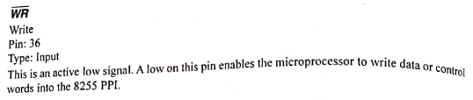
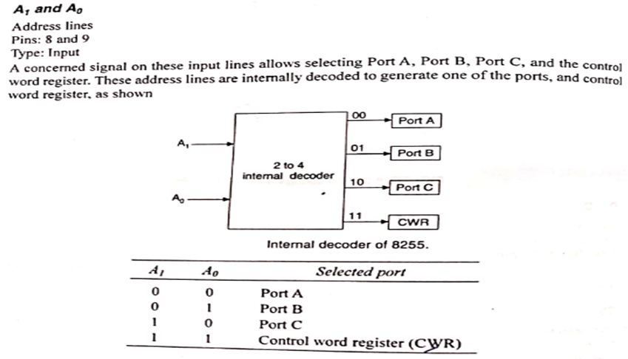

Slide 13
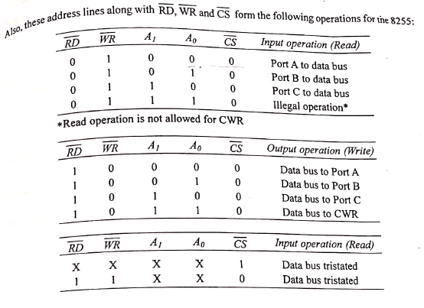

Slide 14
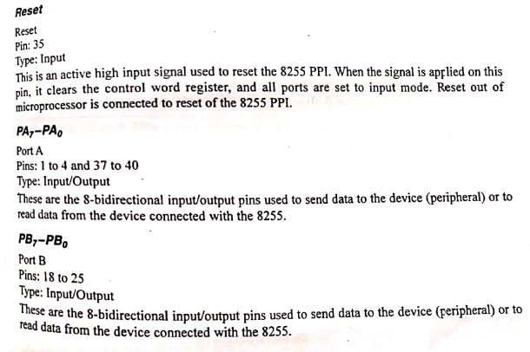

Slide 15
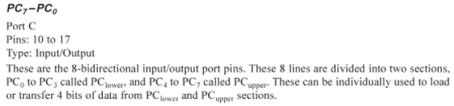

Slide 16
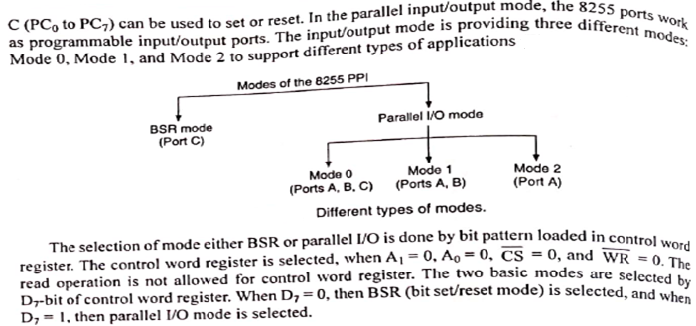
Modes of Operation

Slide 17
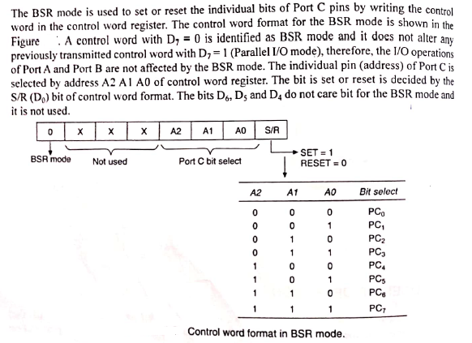
1. BSR Mode

Slide 18
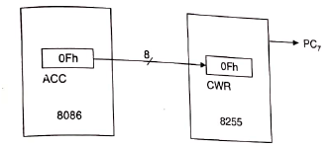
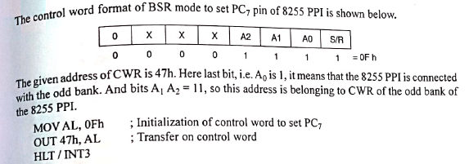
Write a set of instructions to set PC7 pin of 8255 PPI having ctrl word register at 47h.

Slide 19
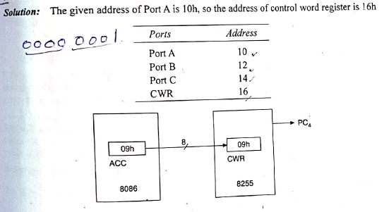
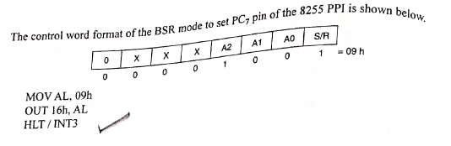
Write a set of instructions to set bit 4 of Port C. Assume the address of Port A is 10H.

Slide 20
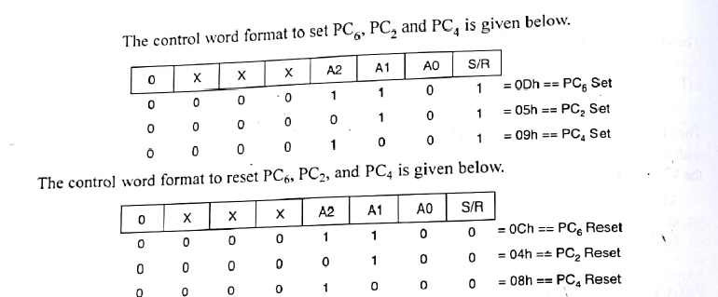
Write an assembly language program to set PC6,PC2 and PC4 bits of Port C, and reset them after 50 ms.

Slide 21
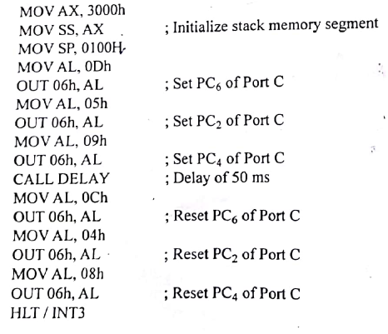
Cont..
Here the address of CWR is not given, so assume add. of Port A is 00h, so the address of CWR is 06h.

Slide 22
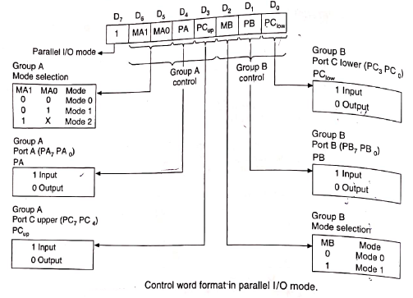
Parallel I/O mode

Slide 23
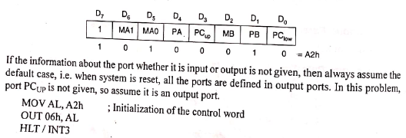
Example 1: Initialize 8255 PPI to define: 1. Port A output in mode 1. 2. Port B input in mode 0. 3. Port C_{low} as output. 8 bit address of CWR is 06h.

Slide 24
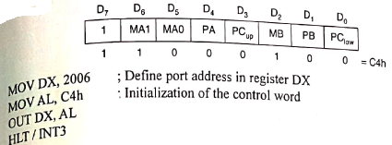
Example 2: Write an initialization sequence to define Port A in mode 2, Port B as output in mode 1. The 16 bit address of CWR is 2006h.

Slide 25
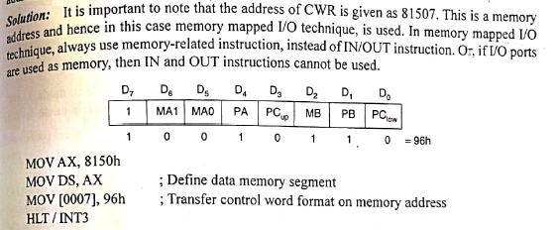
Example 3: Define the 8255 PPI Port A as input in mode 0, Port B as input in mode 1. The address of control word register is 81507.

Slide 26
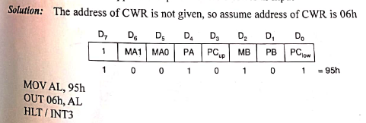
Example 4: Write a set of Instructions to perform the following: 1. Initialize Port A as input in mode 0 2. Initialize Port B as output in mode 1 3. Initialize Port C upper as output and Port C lower as input

Slide 27
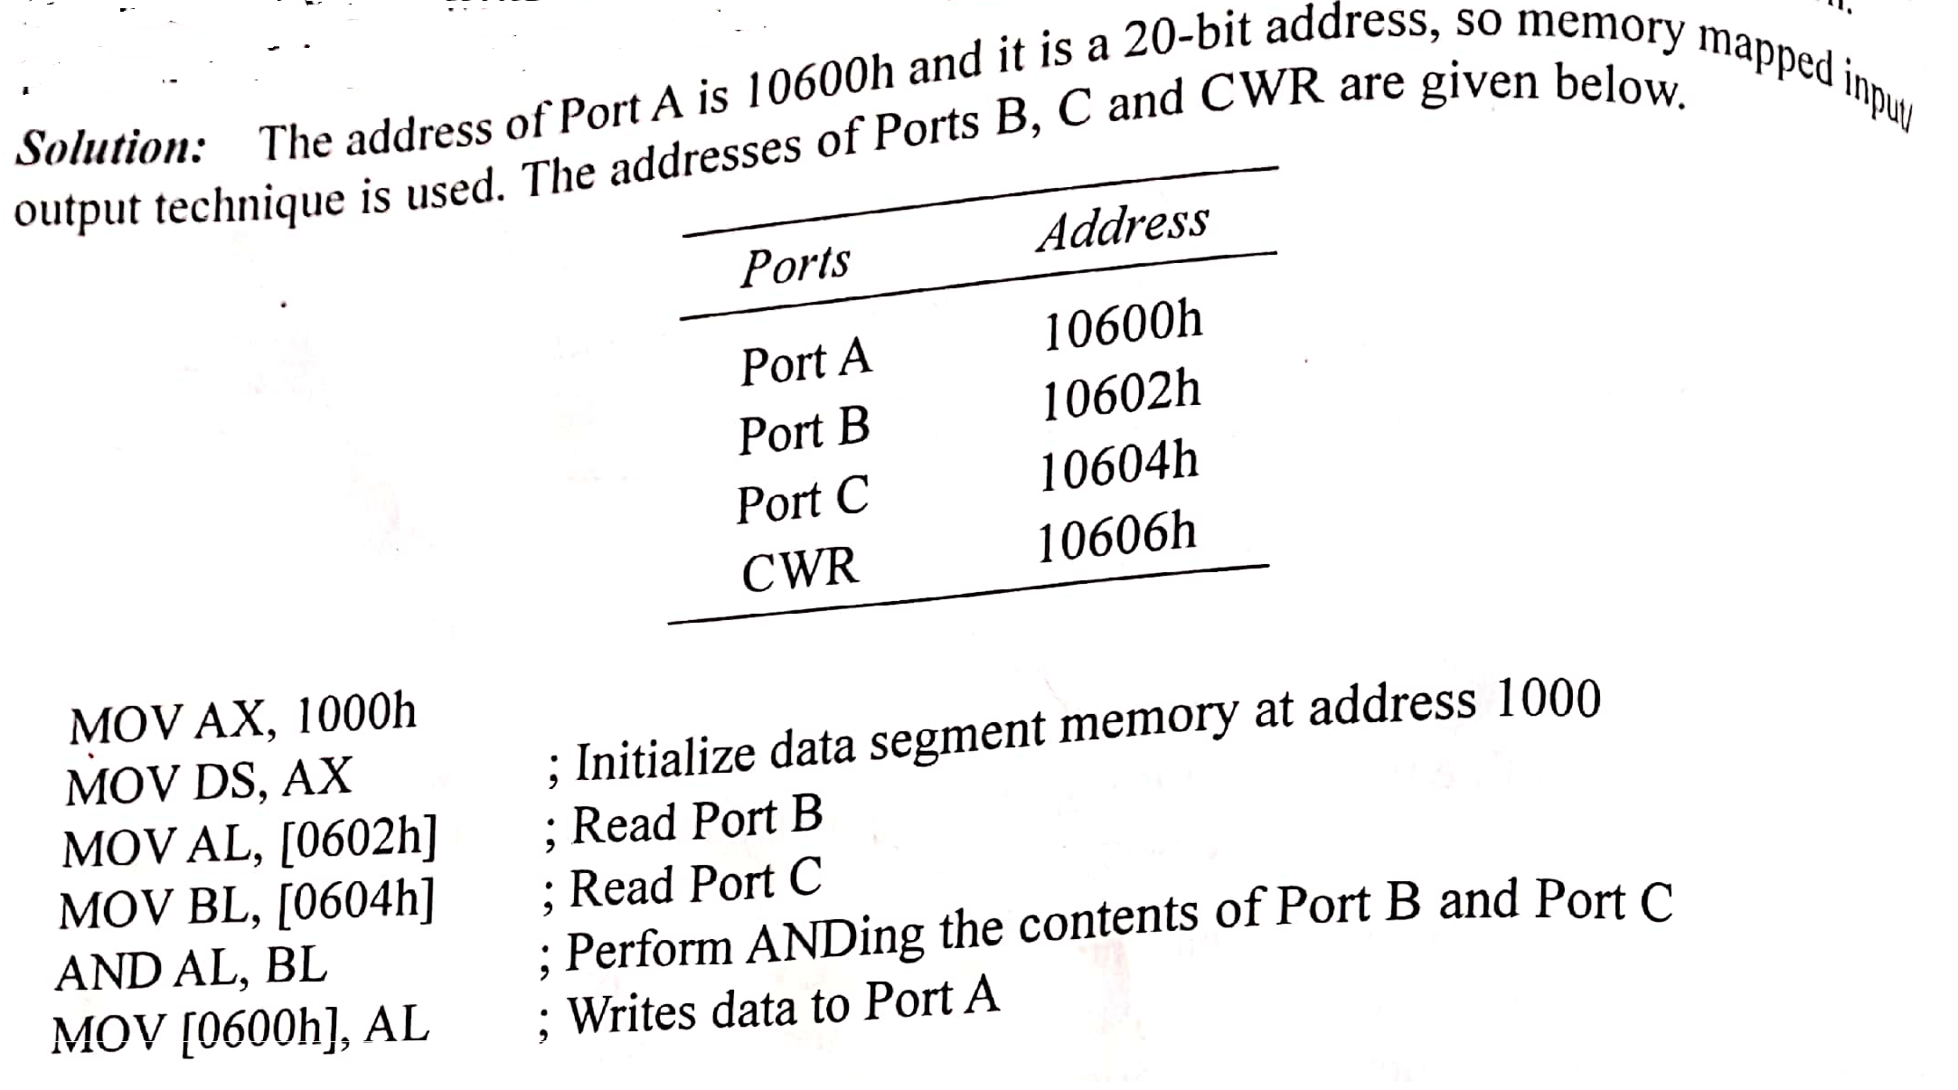
Example 5: Write an ALP that will input the contents of Port B and Port C, and then perform ANDing and output the result to Port A. Port A is connected with address 10600H.

Slide 28


